Slide 1

Copyright © 2012 Pearson Education, Inc.
Notes:
<number>

Slide 2
Chapter 6
Researching and Research Methods
Copyright © 2012 Pearson Education, Inc.
Notes:
<number>

Slide 3
Today you will !
Begin Your Research
Define Your Research Subject
Formulate a Research Question or Hypothesis
Developing a Research Methodology [characteristics of an outline]
Triangulating Materials
Copyright © 2012 Pearson Education, Inc.
Notes:
<number>

Slide 4

Beginning Your Research
Did you start to research and collect information?
Have you faced Information Glut? How did you overcome that?
[Information >Time Available to Collect, Interpret, and Synthesize that Information]
View “Research” as Information Management
Copyright © 2012 Pearson Education, Inc.
Notes:
Primary sources – information collected from observations, experiments, surveys, interviews, ethnographies, and testing
Secondary sources – information drawn from academic journals, magazine articles, books, websites, research databases, DVDs, CD-ROMs, and reference materials
Most researchers begin by locating secondary sources. Primary research can expand on already existing materials.
<number>

Slide 5
Beginning Your Research
Research: is a process of shaping the flow of information so that you can locate and use the information you need
As an information manager, you need to evaluate, prioritize, interpret, and store that information so you can use it effectively
Copyright © 2012 Pearson Education, Inc.
Notes:
Primary sources – information collected from observations, experiments, surveys, interviews, ethnographies, and testing
Secondary sources – information drawn from academic journals, magazine articles, books, websites, research databases, DVDs, CD-ROMs, and reference materials
Most researchers begin by locating secondary sources. Primary research can expand on already existing materials.
<number>

Slide 6
Types of Resources
Which is more reliable ? You prefer?
observations, experiments, surveys, interviews, ethnographies, and testing
academic journals, magazine articles, books, websites, research databases, DVDs, CD-ROMs, and reference materials
Primary Sources
Secondary Sources
Copyright 2011 © by Pearson Education, Inc.
Notes:
Primary sources – information collected from observations, experiments, surveys, interviews, ethnographies, and testing
Secondary sources – information drawn from academic journals, magazine articles, books, websites, research databases, DVDs, CD-ROMs, and reference materials
Most researchers begin by locating secondary sources. Primary research can expand on already existing materials.
<number>

Slide 7
An interview that you conduct is which type of source?
Primary source
Secondary source
Quantitative source
Print source
Copyright © 2012 Pearson Education, Inc.
Notes:
<number>

Slide 8
An interview that you conduct is which type of source?
Primary source
Secondary source
Quantitative source
Print source
Copyright © 2012 Pearson Education, Inc.
Notes:
<number>

Slide 9
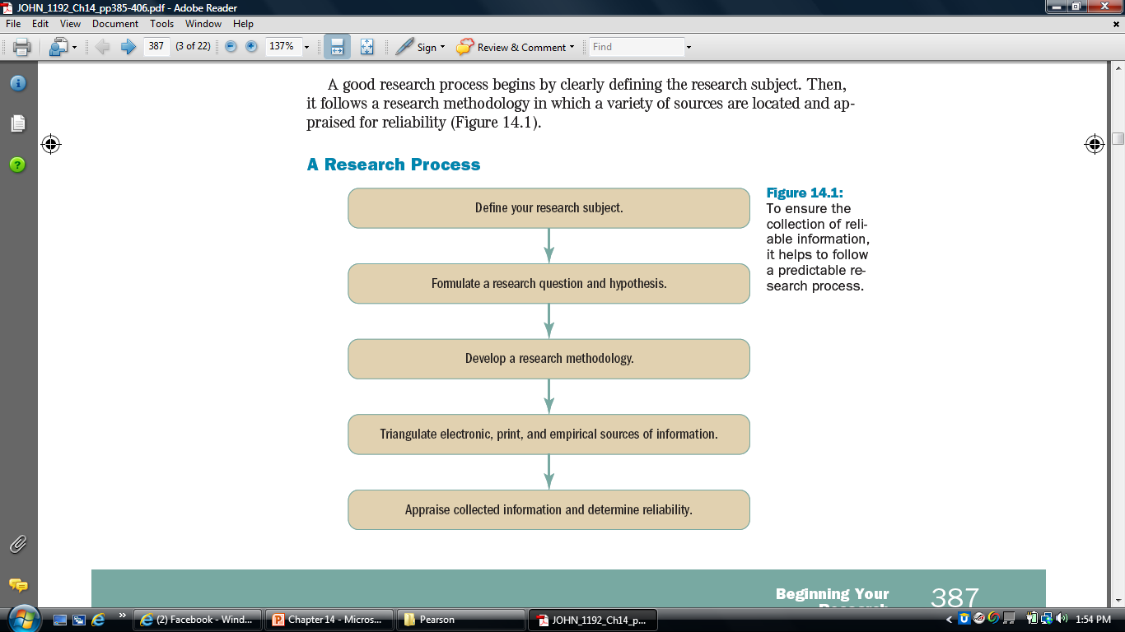
Notes:
<number>

Slide 10

1-Defining Your Research Subject
Develop a Logical Map
Identify What You Know
Highlight areas that need more research
[Violence among children]
“The subjects are too many to be handled in the time available.”
Narrow Your Research Subject
[ Effect of Violent T.V. shows on boys]
Choose an angle on the subject
Copyright © 2012 Pearson Education, Inc.
Notes:
An angle is a specific direction that your research will follow. It will allow you to narrow your research subject to a manageable size.
<number>

Slide 11
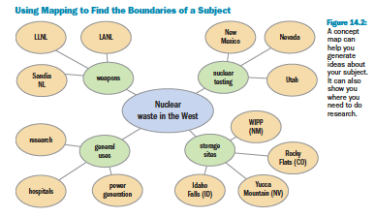
Logical Map / Brainstorm
Copyright © 2015, 2012, 2010 by Pearson Education, Inc. All rights reserved.
Notes:
This concept map helps visualize boundaries on the topic of “Nuclear Waste in the West.”
<number>

Slide 12
General Subject (too broad) | Angled research area (narrowed)
Nuclear waste | Transportation of nuclear waste in western states
Raptors | Bald eagles on the Mississippi
Lung Cancer | Effects of secondhand smoke
Water Usage | Water Usage on the TTU campus
Violence | Domestic abuse in rural areas
Copyright 2011 © by Pearson Education, Inc.

Slide 13
2-Formulating a Research Question or Hypothesis
A Research Question:
It is a question or statement that is tentatively used to guide empirical or analytical research.
It does not need to be very specific when you begin your research.
It simply needs to give your research a direction to follow.
.
Notes:
At first, the research question doesn’t need to be very specific. It needs to guide your research.
As you move forward, you will refine or sharpen your original research question and hypothesis.
<number>

Slide 14
2-Formulating a Research Question or Hypothesis
“What are the effects of violent television on boys between the ages of 10 and 16?”
“Is solar power a viable energy source for South Dakota?”
.
Notes:
At first, the research question doesn’t need to be very specific. It needs to guide your research.
As you move forward, you will refine or sharpen your original research question and hypothesis.
<number>

Slide 15
Hypothesis: Best Guess about an Answer to Your Research Question
“Boys between the ages of 10 and 16 model what they see on violent T.V., causing them to be more violent than boys who do not watch violent T.V.”
“Solar power is a viable energy source in summer, but cloudiness in the winter makes it less economical than other forms of renewable energy.”
.
Notes:
At first, the research question doesn’t need to be very specific. It needs to guide your research.
As you move forward, you will refine or sharpen your original research question and hypothesis.
<number>

Slide 16
What is the problem that you are proposing [Topic ] ? “Research question”
What is your claim / answer to the question? “ Hypothesis”
Copyright 2011 © by Pearson Education, Inc.

Slide 17
3-Developing a Research Methodology
_Step-by-Step Procedure That You Will Use to Study Your Subject
Map out a methodology
[ Purpose - > “How are we going to achieve this purpose?” ]
Describe your methodology
[ outline form - State your expected findings]
Use and revise your methodology
[note deviations in your methodology]
Copyright © 2012 Pearson Education, Inc.
Notes:
Map out a methodology – put the purpose of your research in the middle of your screen or paper. Ask, “How are we going to achieve this purpose?” Formulate two to five major steps to take in research and break them down further.
Describe your methodology – describe your methodology in outline form. State your expected findings.
Use and revise your methodology – note deviations in your methodology.
<number>

Slide 18
Map out a methodology
Copyright © 2012 Pearson Education, Inc.
Notes:
Map out a methodology – put the purpose of your research in the middle of your screen or paper. Ask, “How are we going to achieve this purpose?” Formulate two to five major steps to take in research and break them down further.
Describe your methodology – describe your methodology in outline form. State your expected findings.
Use and revise your methodology – note deviations in your methodology.
<number>

Slide 19
3-Developing a Research Methodology
Map out a methodology
Methodology for Researching Nuclear Waste Transportation:
• Collect information off the Internet from sources for and against nuclear waste storage and transportation.
• Track down news stories in the print media and collect any journal articles available on nuclear waste transportation.
Copyright © 2012 Pearson Education, Inc.
Notes:
Map out a methodology – put the purpose of your research in the middle of your screen or paper. Ask, “How are we going to achieve this purpose?” Formulate two to five major steps to take in research and break them down further.
Describe your methodology – describe your methodology in outline form. State your expected findings.
Use and revise your methodology – note deviations in your methodology.
<number>

Slide 20
3-Developing a Research Methodology
Map out a methodology
Methodology for Researching Nuclear Waste Transportation (contd :)
• Interview experts and survey members of the general public.
• Study the Waste Isolation Pilot Plant (WIPP) in New Mexico to see if transportation to
the site has been a problem.
Copyright © 2012 Pearson Education, Inc.
Notes:
Map out a methodology – put the purpose of your research in the middle of your screen or paper. Ask, “How are we going to achieve this purpose?” Formulate two to five major steps to take in research and break them down further.
Describe your methodology – describe your methodology in outline form. State your expected findings.
Use and revise your methodology – note deviations in your methodology.
<number>

Slide 21
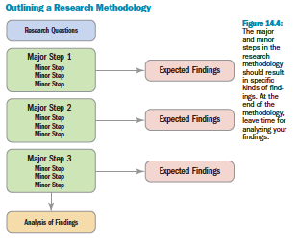
Describe your methodology
Copyright © 2015, 2012, 2010 by Pearson Education, Inc. All rights reserved.

Slide 22
Which of the following is true of research methodologies?
You should avoid deviating from your research methodology
You should formulate one or two steps for your research methodology
You should state your expected findings
All of the above
Copyright © 2012 Pearson Education, Inc.
Notes:
<number>

Slide 23
Which of the following is true of research methodologies?
You should avoid deviating from your research methodology
You should formulate one or two steps for your research methodology
You should state your expected findings
All of the above
Copyright © 2012 Pearson Education, Inc.
Notes:
<number>

Slide 24
What is an outline?
An outline is a general plan of what you are going to write.
You can compare making an outline to drawing plans to build a house.

Slide 25
Benefits of an Outline
An outline of an essay can be very helpful for many reasons:
An outline will help make your essay more organized. A careful plan will help your body paragraphs stay focused on the ideas in your thesis statement.
An outline saves time for writers. Preparing an
outline can take time, but when you are finished, you
will be able to write the rough draft of your essay
more quickly than if you didn’t have an outline.

Slide 26
Benefits of an Outline
An outline shows logical relations between ideas (e.g. contrast, addition, result)
Connects body paragraphs to the thesis statement (topic sentences of paragraphs are a break down of the thesis statement)

Slide 27
Prewriting Stage How To Develop an Outline?
Levels of detail (from general to specific)
I
Capital roman numbers for listing main heading of sections
A
Capital letters for listing subheadings of main section,
(OR for listing main ideas of paragraphs inside section)
1
Numbers for listing ideas of paragraphs inside section,
(OR for listing main details inside paragraph)
a
Small letters for listing main details inside paragraph,
(OR for listing minor details inside paragraph)
Higher levels of details (I, A) ; Lower levels of details (1, a)

Slide 28
How to Develop an Outline
Main Characteristics of an Outline
Parallelism
Coordination
Subordination

Slide 29
How to Develop an Outline
Parallelism
Topic: Why study technical communication
I. Importance of technical communication
II. Frequency of technical communication
Tip: If the first heading is a noun, the second heading should be a noun.

Slide 30
How to Develop an Outline
Coordination
Topic: Why study technical communication
I. Importance of technical communication
II. Frequency of technical communication
Tip: All information contained in Heading 1 should have the same significance as the information contained in Heading 2.

Slide 31
How to Develop an Outline
Subordination
Topic: Why study technical Communication
I. Importance of technical communication
A. Communication skills rank higher than other skills
Tip: The information in the headings should be more general, while the information in paragraphs should be more specific.

Slide 32
How to Develop an Outline
Division
Topic: Why study technical communication
I. Importance of technical communication
A. Communication skills rank higher than other skills
Tip: Each heading should be divided into 2 or more paragraphs.

Slide 33
4-Triangulating Materials
Solid Research Draws from 3 Kinds of Information
Electronic sources
[ DVDs- websites- research databases- television –
radio- blogs]
Print sources
[ books- journals- magazines- newspapers- microfiche]
Empirical sources
( studies can be: quantitative -> trends – qualitative-> behavior) [ Experiments- Field Observation- Interviews- Surveys- Ethnographies- Case Studies]
3= confident – reliable 2= less confident – reliable
Copyright © 2012 Pearson Education, Inc.
Notes:
Electronic sources include websites, DVDs, CD-ROMs, listservs, research databases, television and radio, videos, podcasts, blogs
Print sources include books, journals, magazines and newspapers, government publications, reference materials, microform/microfiche
Empirical sources – experiments, surveys, interviews, field observations, ethnographies, case studies
Empirical studies can be quantitative (data that can be analyzed to find trends) or qualitative (patterns of behavior that aren’t numbers)
By using all three types, you can verify facts:
If you find similar facts in all three kinds of sources, you can be reasonably confident that the information is reliable
If you find information in two or three kinds of sources, the information is probably still reliable, though you should be less confident
If, however, you find the information in only one kind of source, it might not be reliable and needs further consideration.
<number>

Slide 34
A survey is which type of source?
Electronic
Empirical
Secondary
Print
Copyright © 2012 Pearson Education, Inc.
Notes:
<number>

Slide 35
A survey is which type of source?
Electronic
Empirical
Secondary
Print
Copyright © 2012 Pearson Education, Inc.
Notes:
<number>

